Slide 1

Plague of fare evasion
By - Yanchao, Hanna, Charan

Slide 2
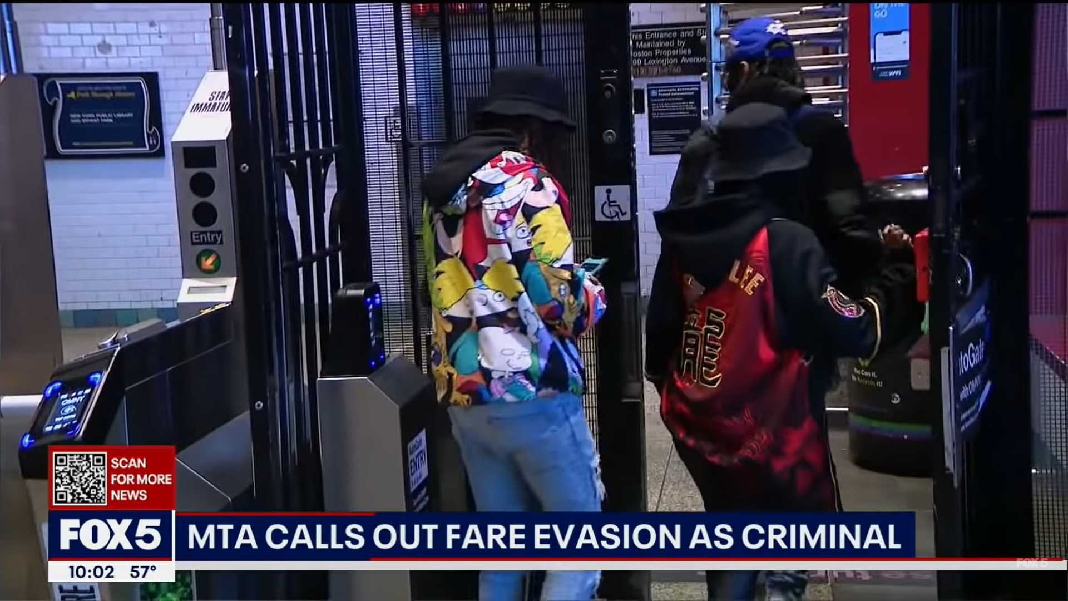
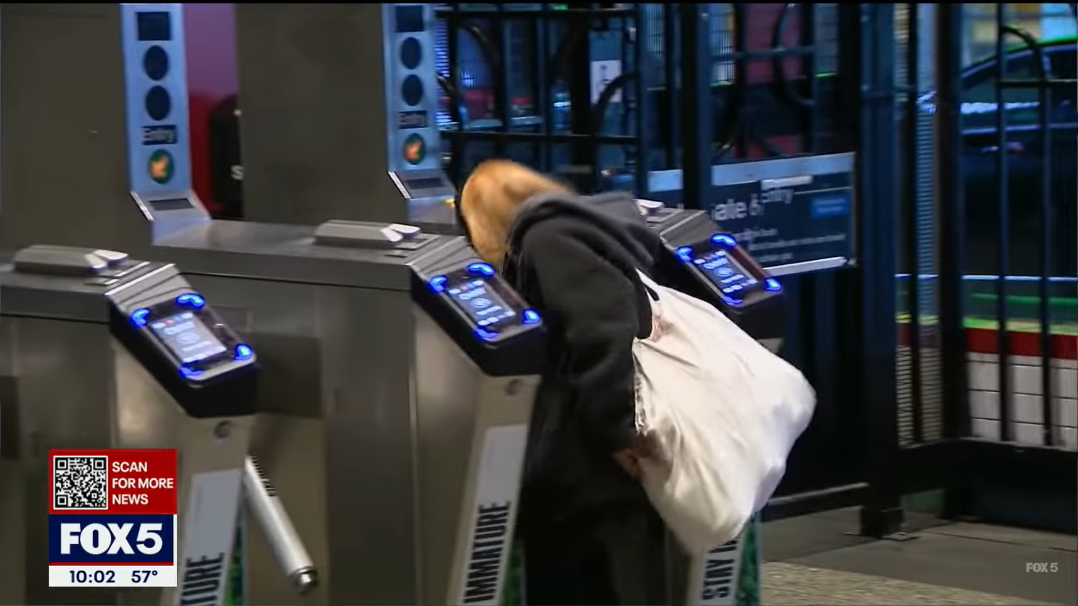
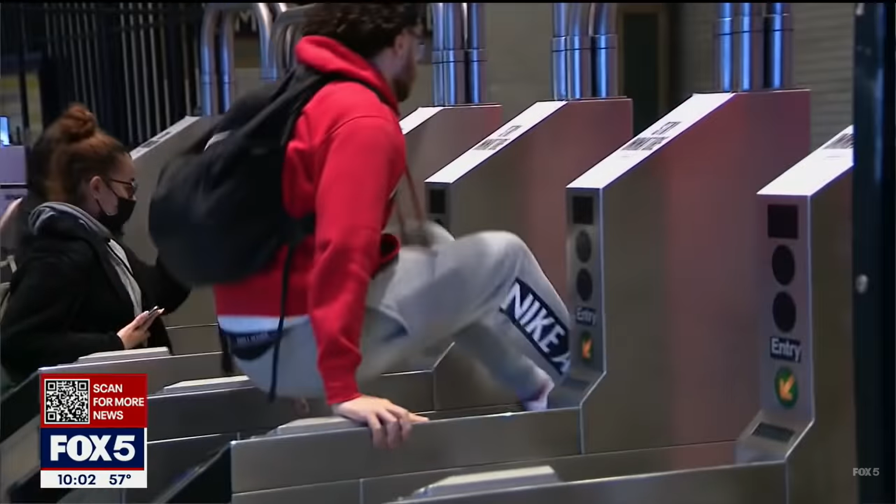
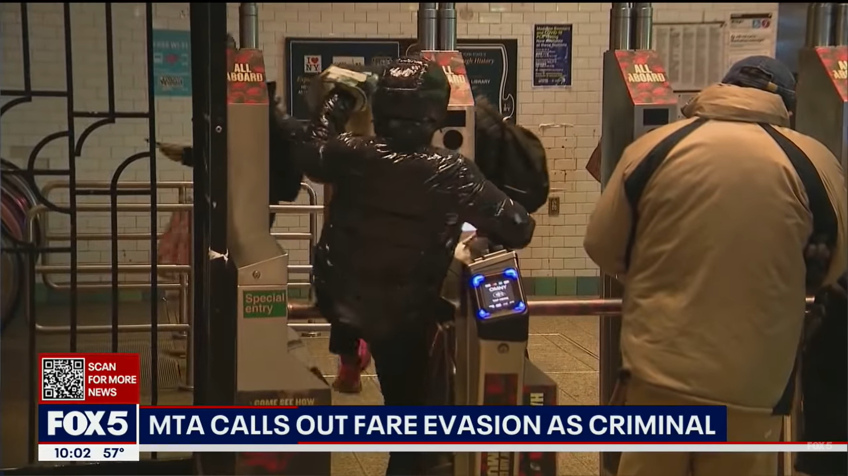
WHY DOES IT MATTER ?
“Not every fare evader is a criminal, but experience has shown that virtually every criminal is a fare evader.”
“We’ve got to make the riders feel safe again — that’s the bottom line — what they’re telling us [is] they want to see more police. That’s what they’re telling us.” Lieber ,CEO MTA

Slide 3
“
Every minute around 350 people evade fare. MTA bares a loss of ~ 500 million every year just on Subway and path.

Slide 4
LOGIC
Assumptions

Slide 5
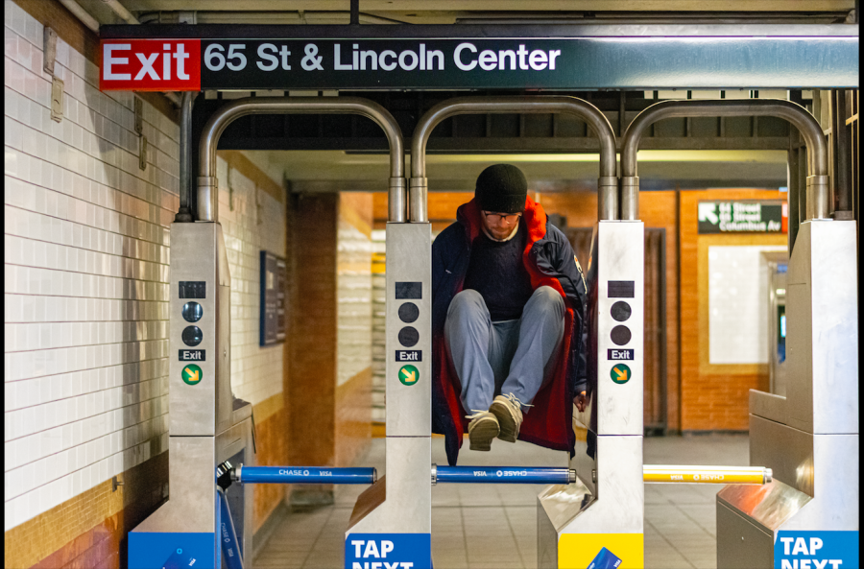
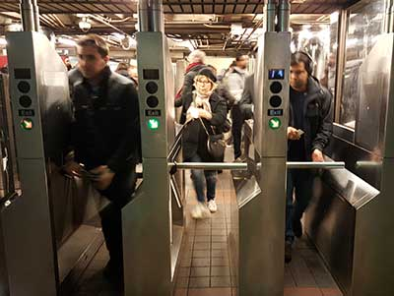
ENTRY ∦ EXIT
ENTRY
EXIT

Slide 6
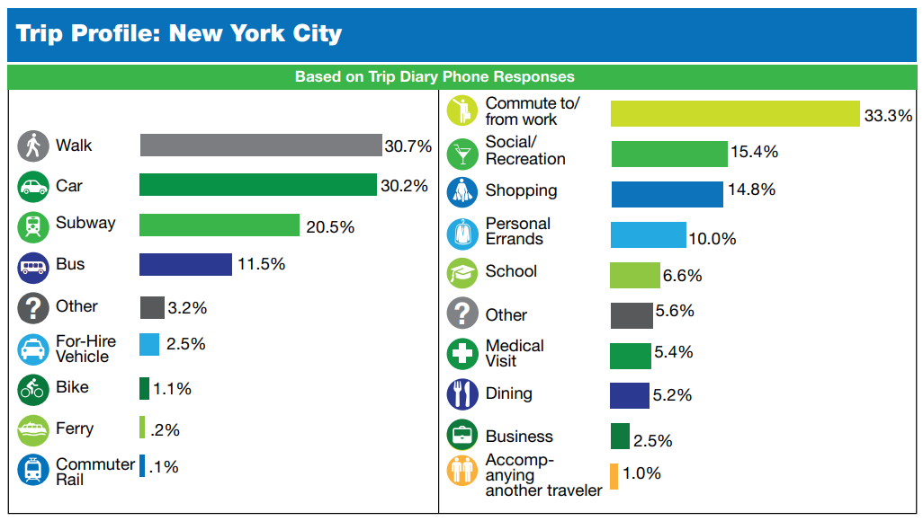
ENTRY = EXIT
Source : New York City Mobility Report, NYC Department of Transportation, August 2019

Slide 7
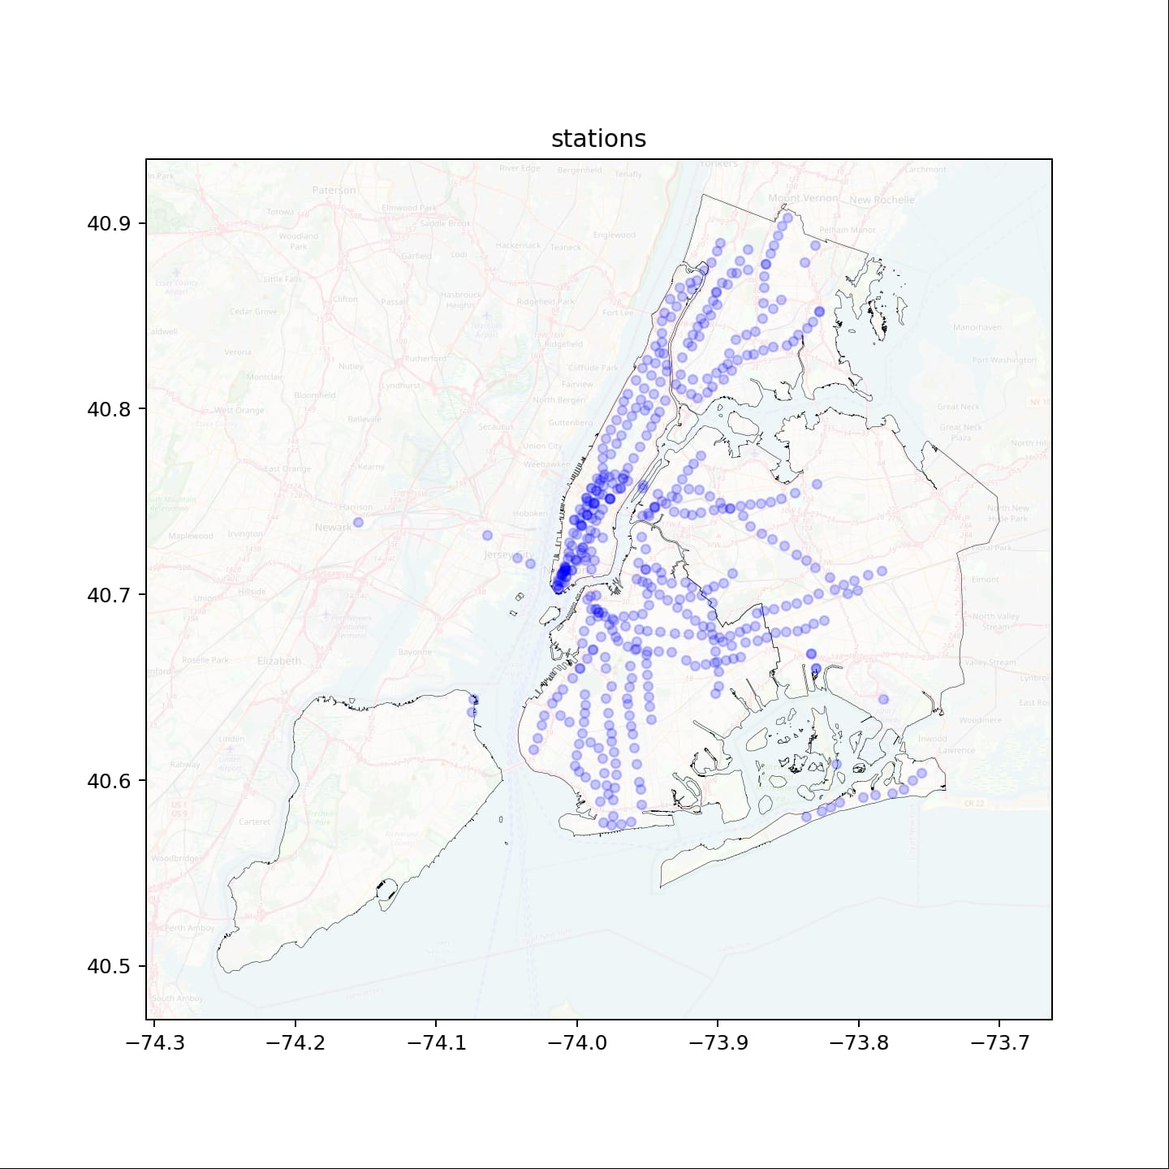
Game of 379 (underground)

Slide 8
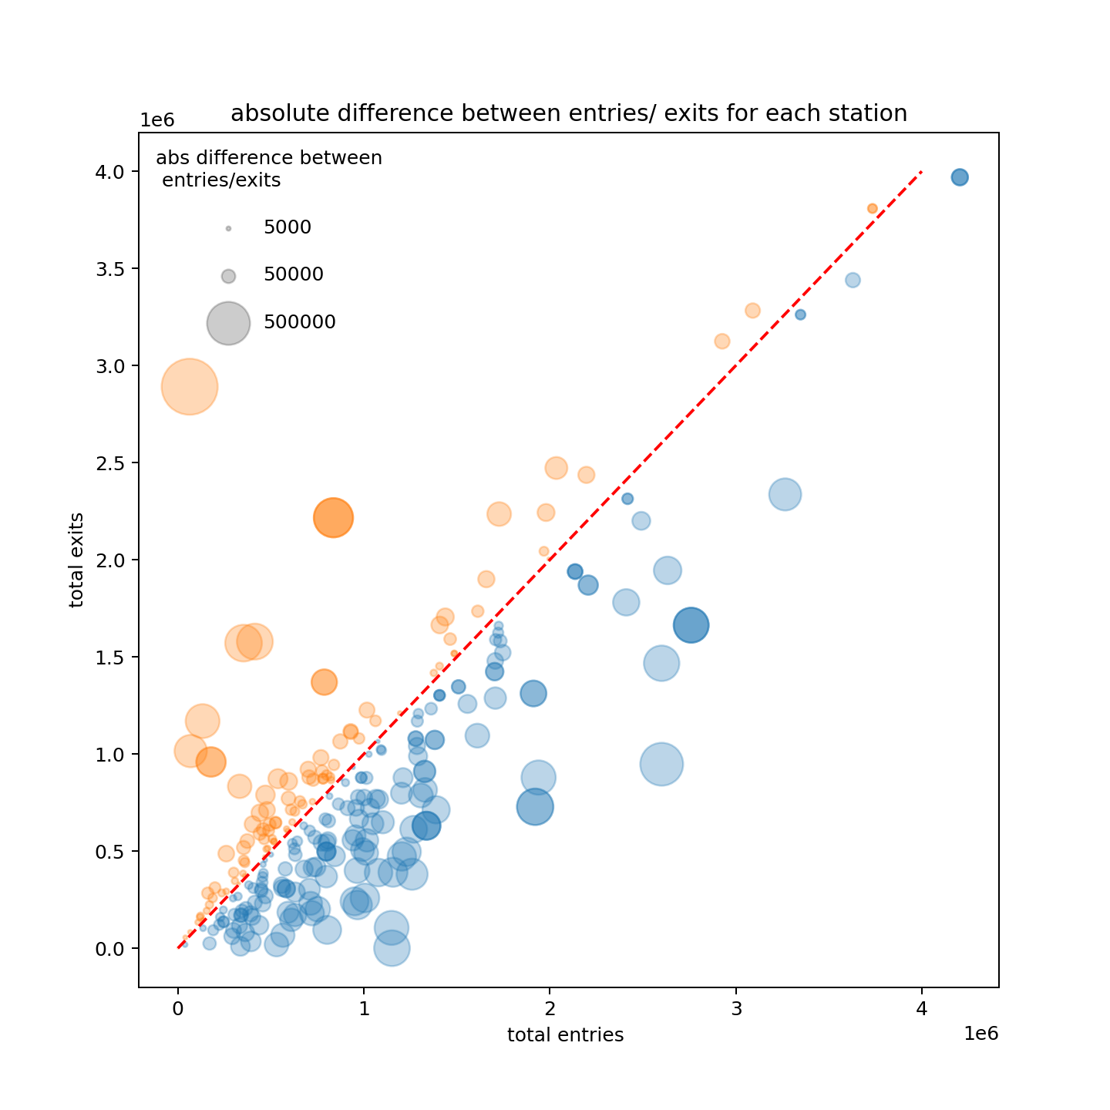
The Race
Most of the stations located close to the red line, meaning the yearly total entries and exits are in equilibrium.
Some stations are relatively more popular destinations, while others are popular origins.
9.4% stations having total entries obviously larger than total exits, which might be interesting to focus on.
Orange: total entries < total exits,
Blue: total entries > total exits

Slide 9
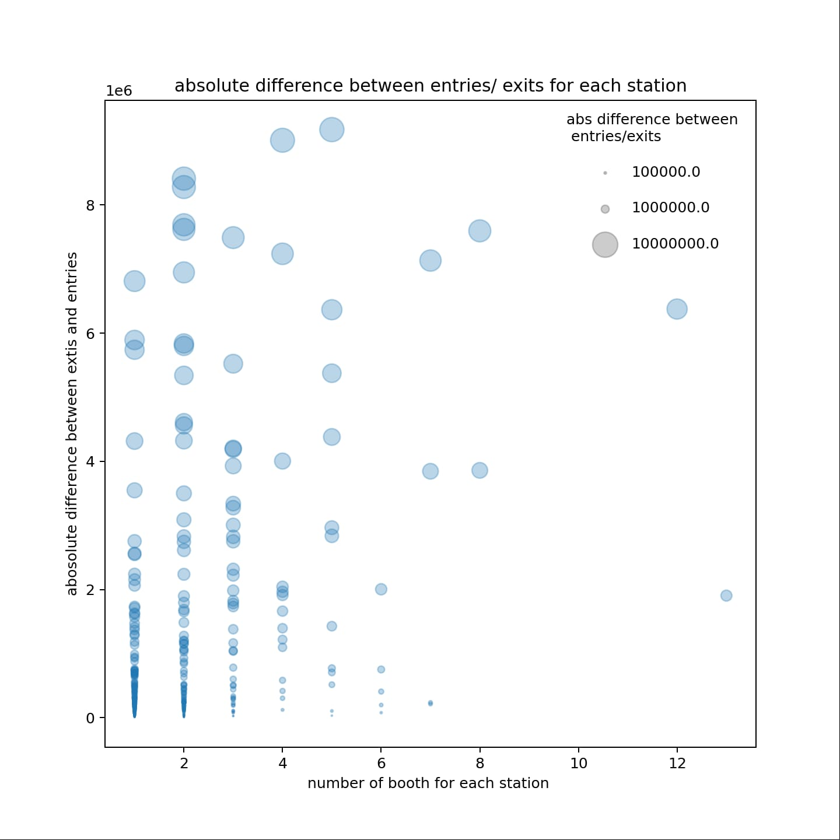
JUST CHECKING IF IT’S A Fair Race
30 stations account more than half of fare evasion trips
The stations where there are entry/Exit but no booths have higher Fare evasions

Slide 10
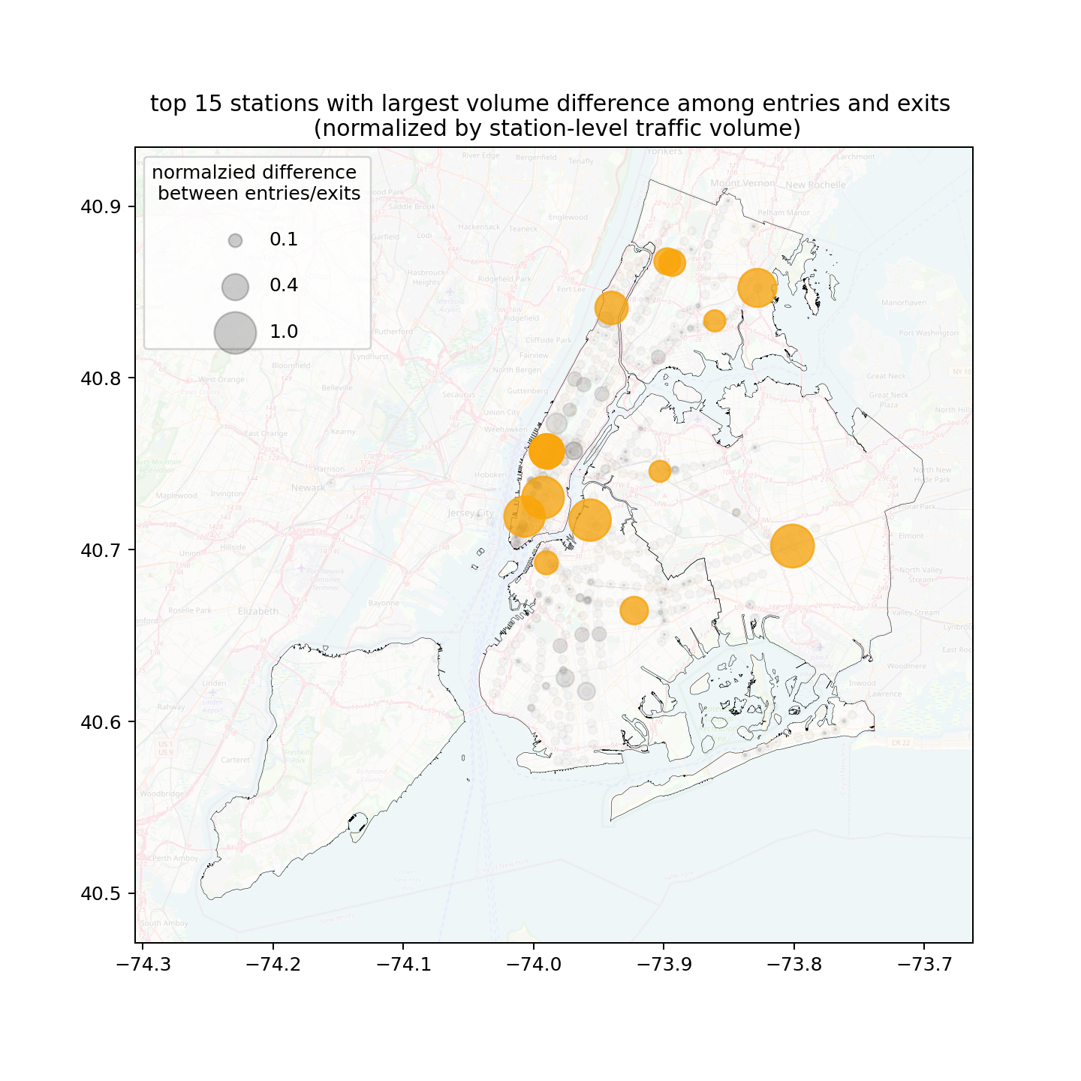
The Winners (Pound to Pound)
JAMAICA CENTER - 0.9
8 ST-NYU - 0.89
BEDFORD AV - 0.88
FRANKLIN ST
ORCHARD BEACH
NEWARK HM HE
42 ST-PORT AUTH
168 ST
SUTTER AV-RUTLD
BOROUGH HALL
61 ST WOODSIDE

Slide 11
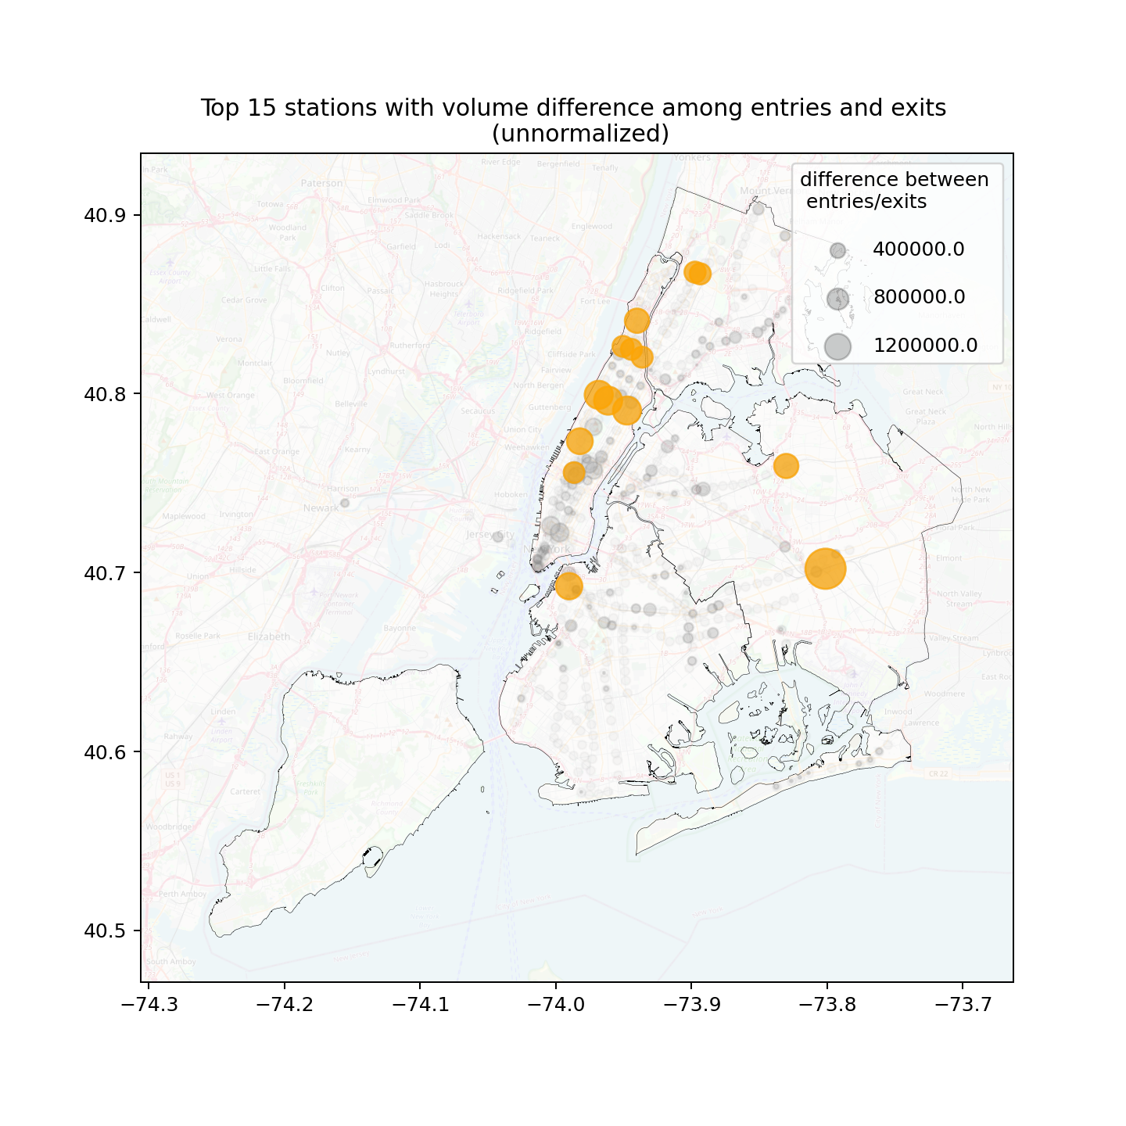
The Winners (Max Jumps)
The top 15 stations account to 23.4%
JAMAICA CENTER - 2.7 million
103 ST - 1.4 million
BOROUGH HALL - 1.2 million
66 ST-LINCOLN
168 ST
FLUSHING-MAIN
NEWARK HM HE
KINGSBRIDGE RD
145 ST
TIMES SQ-42 ST

Slide 12

“
Listen to the data and Secure the stations

